Slide 1
EEE141.11 Summer 2020
01/07/2020
Introductory Class

Slide 2
Class Information
Course Name: Electrical Circuits I
Course Code: EEE141
Credit Hours: 3
Pre-requisites: MAT 120 (Calculus and Analytic Geometry I)
Class time: MW 09:40 AM – 11:10 AM
Google Classroom Code: rfum3ra
Google Meet Link: https://meet.google.com/lookup/fwkitduzu3?authuser=0&hs=179

Slide 3
Instructor Information
Instructor Name: Dr. Riasat Khan (RTk)
Position: Assistant Professor, ECE
Email: riasat.khan@northsouth.edu
Office: SAC 920

Slide 4
Course Summary
Formulation and solution of circuit equations using various circuit analysis techniques including Ohm’s law, Kirchhoff’s laws, mesh and nodal analysis, superposition, source conversion, Thevenin’s theorem, Norton’s theorem, and maximum power transfer theorem.
Transient analysis of series RC and RL circuits will be discussed followed by brief introduction of capacitors and inductors.

Slide 5
Textbook
Fundamentals of Electric Circuits, by Alexander & Sadiku, 4th /5th edition (International Edition): Main textbook. Already posted in the Google Classroom
Introductory Circuit Analysis – 12th Edition - Robert L. Boylestad

Slide 6
Course Objectives
Introduce basic concepts applied in simple DC circuits to compute voltage, current, equivalent resistance, energy and power. (Chapter 1)
Introduce basic circuit laws applied in simple DC circuits to compute voltage, current, equivalent resistance and power. (Chapter 2)
Analyze complex circuits using nodal and mesh methods. (Chapter 3)
Simplify circuit analysis using various circuit theorems. (Chapter 4)
Examine the transient analysis of series RC and RL circuits. (Chapter 6 and Chapter 7)

Slide 7
Lecture Plan
 | Contents | Book Sections | # of Lectures
1 | Basic Concepts: Charge, Current, Voltage, Power, Energy, Dependent Source | 1.1-1.6 | 2
2 | Basic Laws: Ohm’s Law, Nodes, Branches & Loops, Kirchhoff’s Laws, Series Resistors & Voltage Div., Parallel Resistors & Current Div., Y-Δ Transformations | 2.1-2.7 | 6
3 | Analysis Methods: Nodal Analysis, Nodal Analysis with Voltage Source, Mesh Analysis, Mesh Analysis with Current Source | 3.1-3.5 | 4
 | MIDTERM EXAM
4 | Circuit Theorems: Linearity Property, Superposition Principle, Source Transformation, Thévenin's, Norton’s & Maximum Power Transfer Theorem | 4.1-4.8 | 6
5 | Capacitors & Inductors: Series & Parallel conf. of Capacitors & Inductors | 6.1-6.5 | 4
6 | First-Order Circuits: Source-Free RC & RL Circuits | 7.1-7.3 | 2

Slide 8
Tentative Marks Distribution
Attendance: 5%
Quiz/Class Test: 25%
Midterm: 30%
Final Exam: 35%
Pop Quiz: 5%

Slide 9
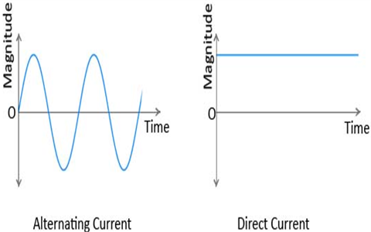

DC Current
Direct current (DC): One directional or unidirectional flow electric charge
Direct current (DC current:
$I=10A$
$I=−10A$

Slide 10
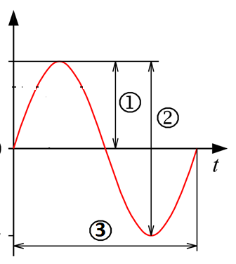
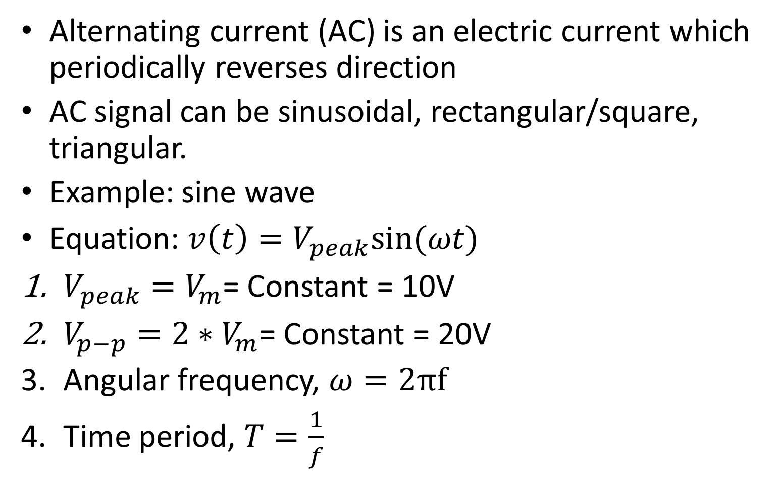

AC Current
Alternating current (AC) is an electric current which periodically reverses direction
AC signal can be sinusoidal, rectangular/square, triangular.
Example: sine wave
Equation: $v\left(t\right)=V_{peak}sin⁡(ωt)$
$V_{peak}=V_{m}$= Constant = 10V
$V_{p−p}=2∗V_{m}$= Constant = 20V
Angular frequency, $ω=2πf$
Time period, $T=\frac{1}{f}$
$$v\left(t\right)$$

Slide 11
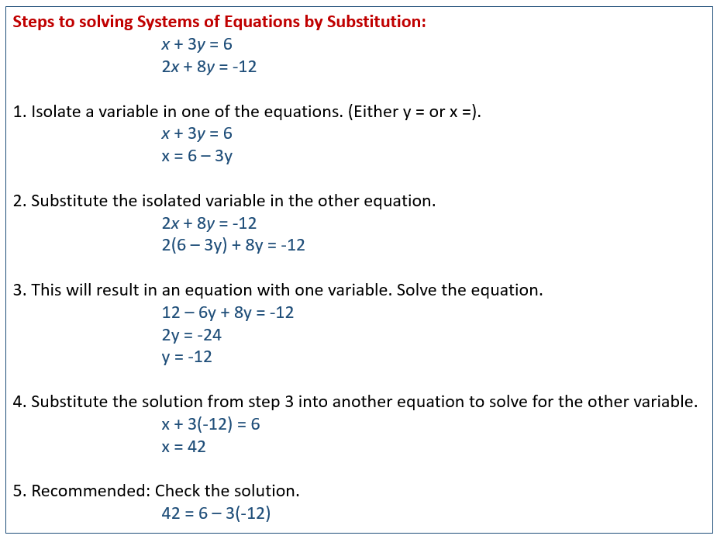
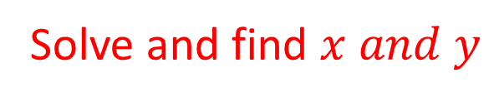
Solving Linear system of equations
Elimination and substitution method
Solve and find $x and y$

Slide 12
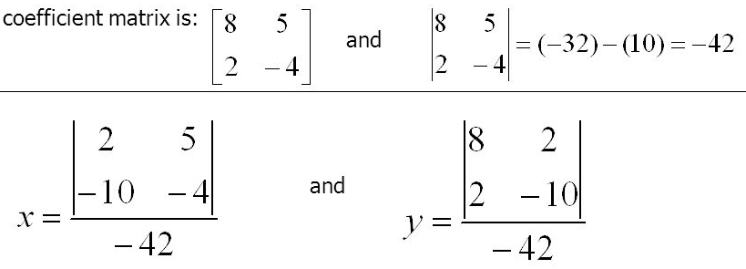



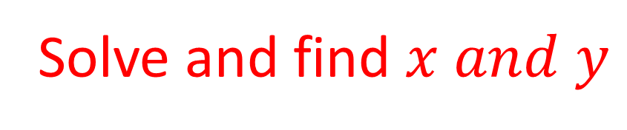
Cramer’s Rule
$ax+by=c$; $a$and$b$ are the coefficients
$8x+5y=2$
$2x−4y=−10$
Solve and find $x and y$
$$=−1$$
$$=2$$

